Slide 1
Cloud Service Models

Slide 2
Introduction to Cloud Computing
Cloud computing provides computing resources over the Internet.
Users can access services anytime and anywhere.
Reduces hardware and maintenance costs.

Slide 3
What are Cloud Service Models?
Service models define how cloud services are delivered.
Different levels of management and control.
Main models:
IaaS
PaaS
SaaS

Slide 4
Need for Cloud Service Models
Cost reduction
Easy scalability
Faster deployment
Better resource utilization

Slide 5
Types of Cloud Service Models
Infrastructure as a Service (IaaS)
Platform as a Service (PaaS)
Software as a Service (SaaS)

Slide 6
Infrastructure as a Service (IaaS)
Provides virtualized computing resources.
Users manage operating systems and applications.
Cloud provider manages hardware.

Slide 7
Cloud Service Model Architecture
User Layer
SaaS Layer
PaaS Layer
IaaS Layer
Physical Infrastructure

Slide 8
Advantages of IaaS
Pay-as-you-use pricing
Flexible resource allocation
Easy disaster recovery
Reduced hardware investment

Slide 9
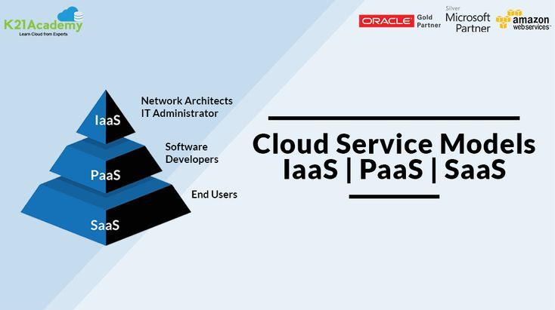

Slide 10
Disadvantages of IaaS
Security responsibilities for users
Requires technical knowledge
Configuration complexity

Slide 11
Features of IaaS
Virtual machines
Storage services
Networking services
High scalability

Slide 12
Examples of IaaS
Amazon Web Services EC2
Microsoft Azure Virtual Machines
Google Cloud Compute Engine

Slide 13
Platform as a Service (PaaS)
Provides development and deployment platforms.
Developers focus on coding.
Provider manages infrastructure.

Slide 14
Advantages of PaaS
Faster application development
Reduced coding effort
Easy collaboration
Automatic updates

Slide 15
Disadvantages of PaaS
Vendor dependency
Limited customization
Security concerns

Slide 16
Software as a Service (SaaS)
Software delivered through the Internet.
No installation required.
Access through web browsers.

Slide 17
Features of SaaS
Subscription-based access
Automatic updates
Multi-user support
Anywhere accessibility

Slide 18
Advantages of SaaS
Easy to use
Low cost
No maintenance
Quick deployment

Slide 19
Disadvantages of SaaS
Internet dependency
Data privacy concerns
Limited customization

Slide 20
Examples of SaaS
Google Workspace
Microsoft 365
Salesforce

Slide 21
Real-Time Applications
Website Hosting (IaaS)
Mobile App Development (PaaS)
Email Services (SaaS)
Online Collaboration Tools

Slide 22
Future of Cloud Service Models
AI Integration
Serverless Computing
Enhanced Security
Edge Computing

